Slide 1
Artificial Neural Network-Based Robotic Control
Master’s Thesis
Justin Ng
June 8, 2018
Committee Chair Committee Member Committee Member | Andrew Danowitz, Ph.D. Xiao-Hua Yu, Ph.D. Fred W. DePiero, Ph.D.

Slide 2
Outline
Outline
Teaser
Introduction/Motivation
Background
Solution
Implementation
Results
Future work and conclusions

Slide 3
Outline
Outline
Teaser
Introduction/Motivation
Background
Solution
Implementation
Results
Future work and conclusions

Slide 4
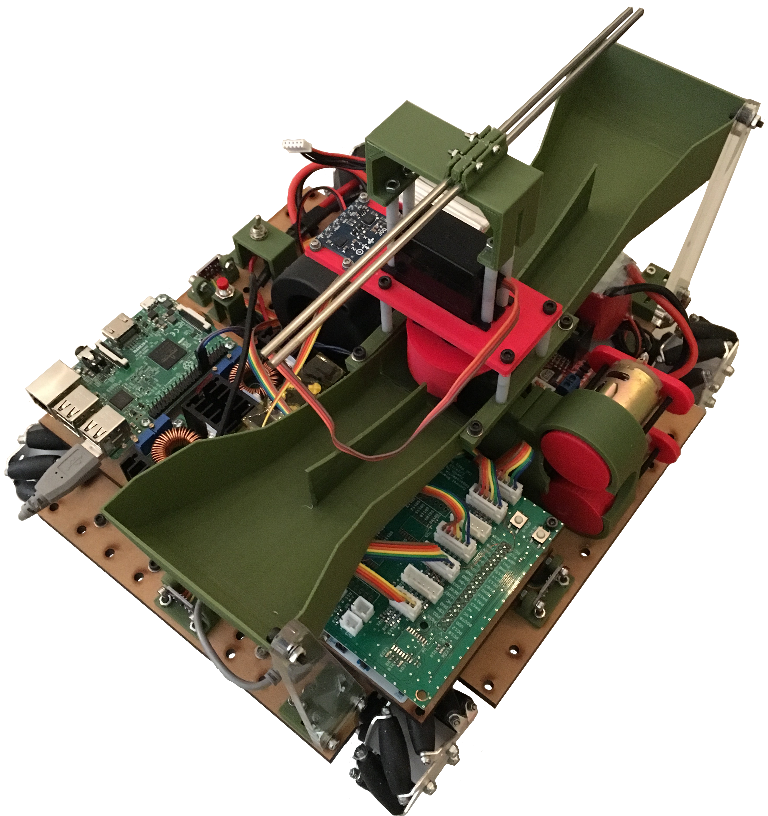
Teaser
Reinforcement learning applied to continuously-controlled robotics.
Controller sets robot’s position and orientation in the environment.

Slide 5
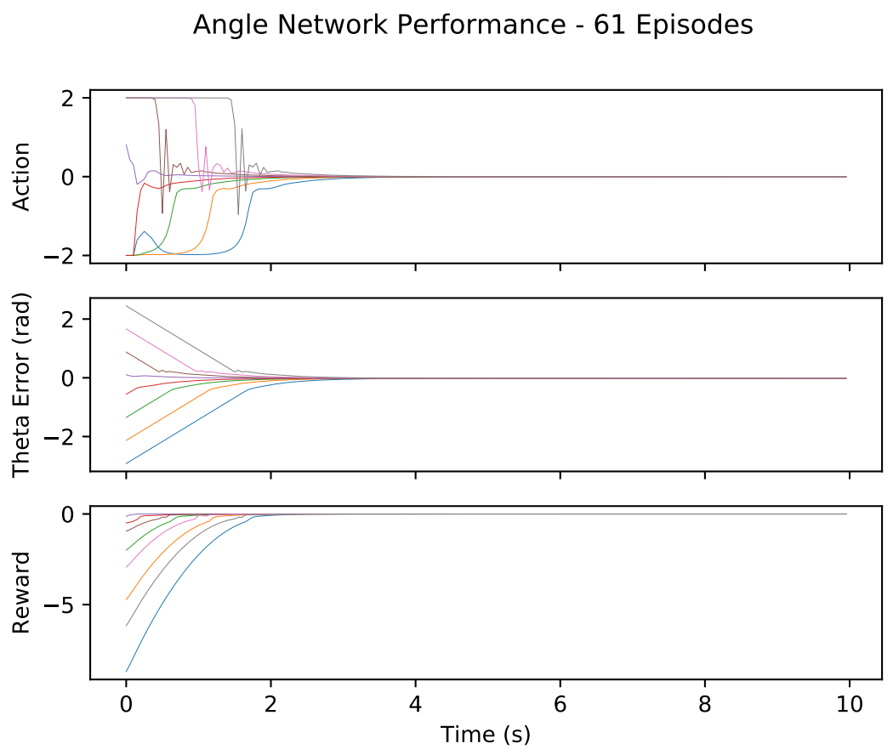
Teaser
Uses deep deterministic policy gradients method developed by DeepMind.
Model-free, actor-critic algorithm implemented with artificial neural networks.

Slide 6
Outline
Outline
Teaser
Introduction/Motivation
Background
Solution
Implementation
Results
Future work and conclusions

Slide 7
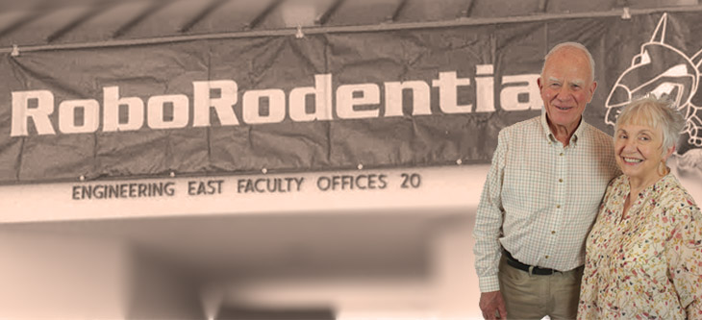
Cal Poly Roborodentia
Annual intramural robotics competition.
Fully autonomous robots.
Different game every year.
Source: http://roborodentia.calpoly.edu/
Notes:
Introduce Roborodentia.

Slide 8
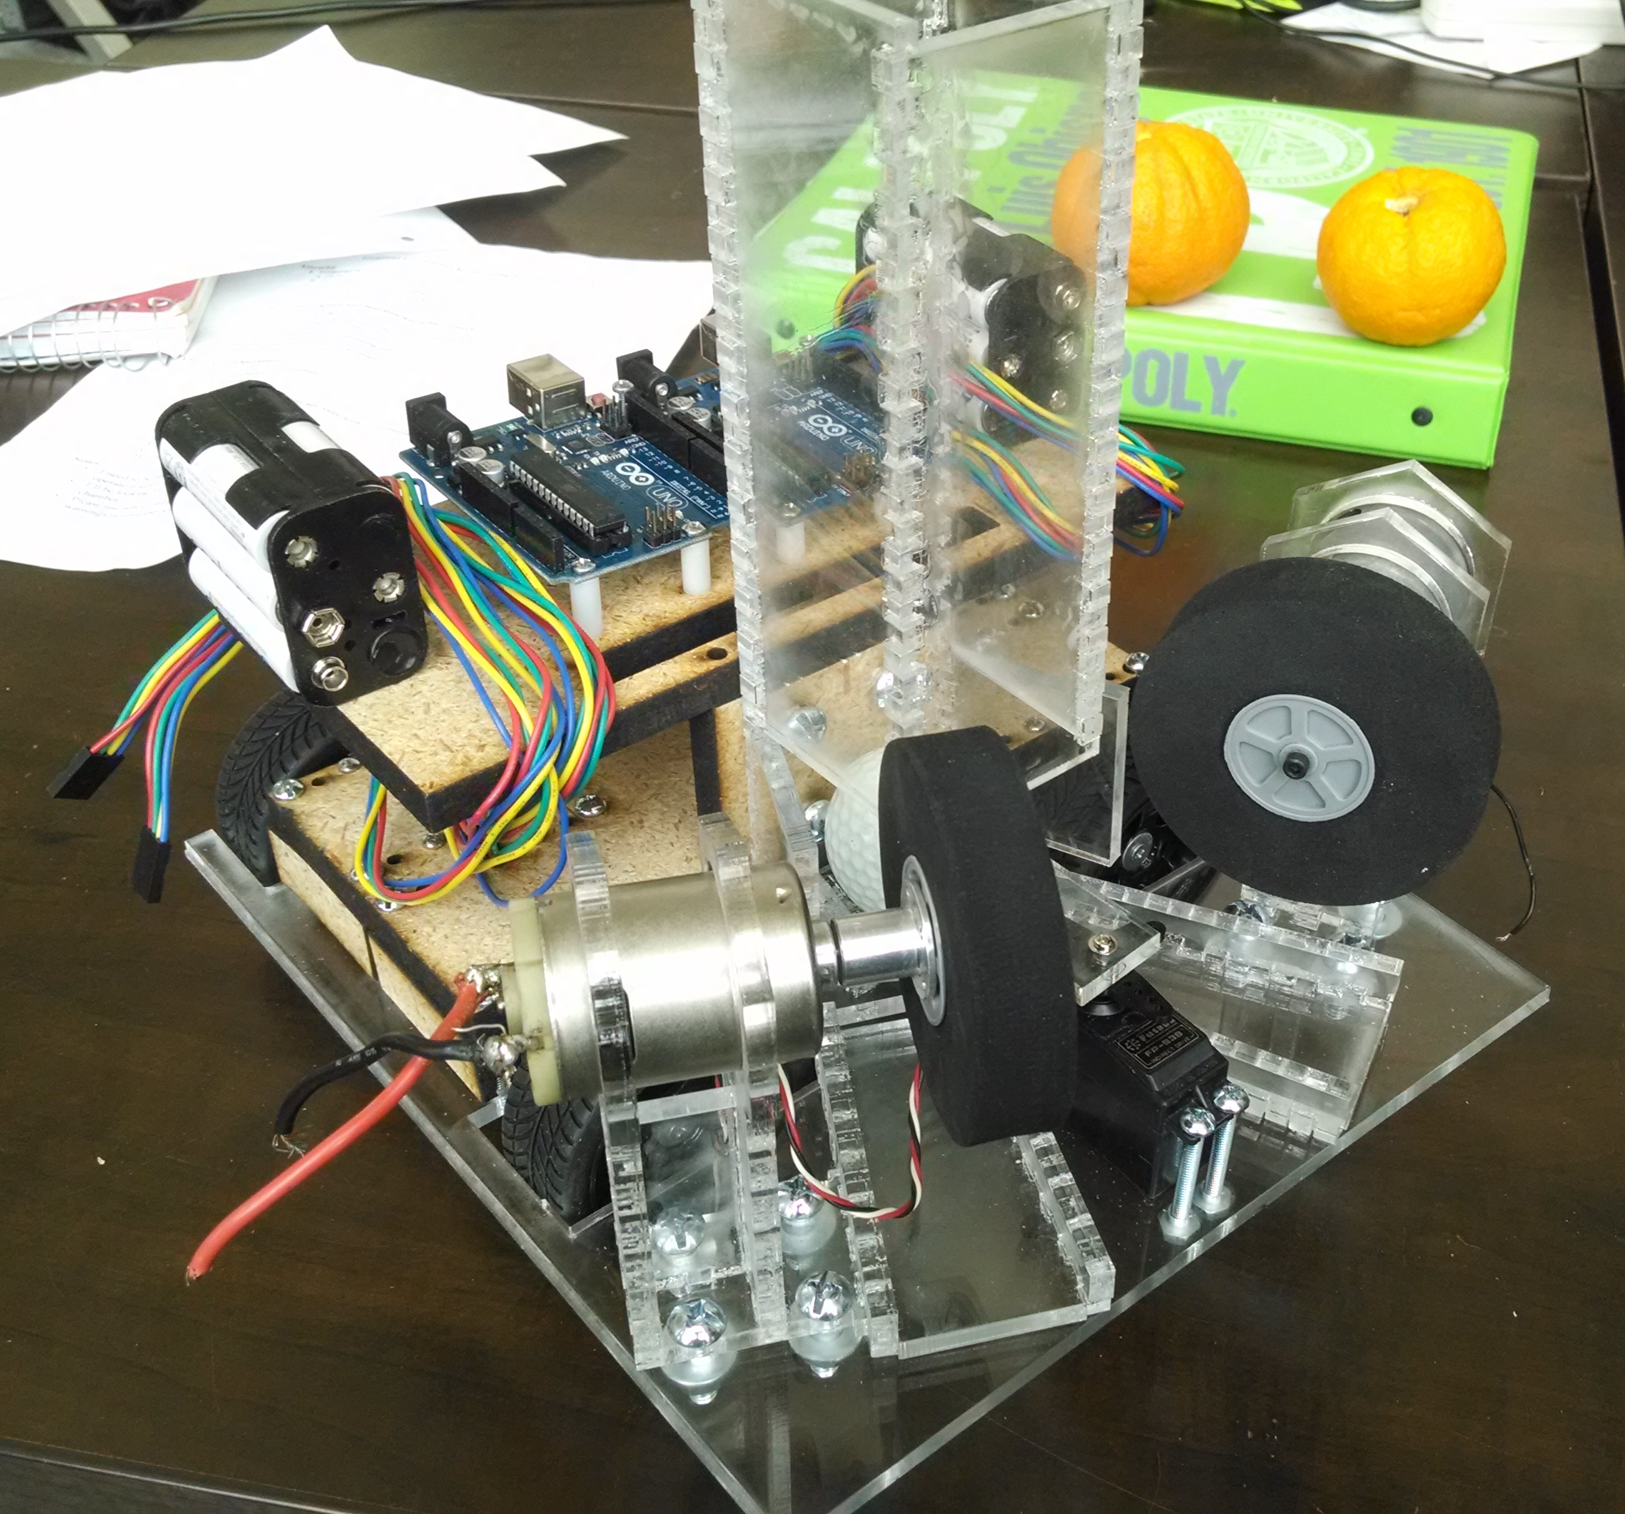
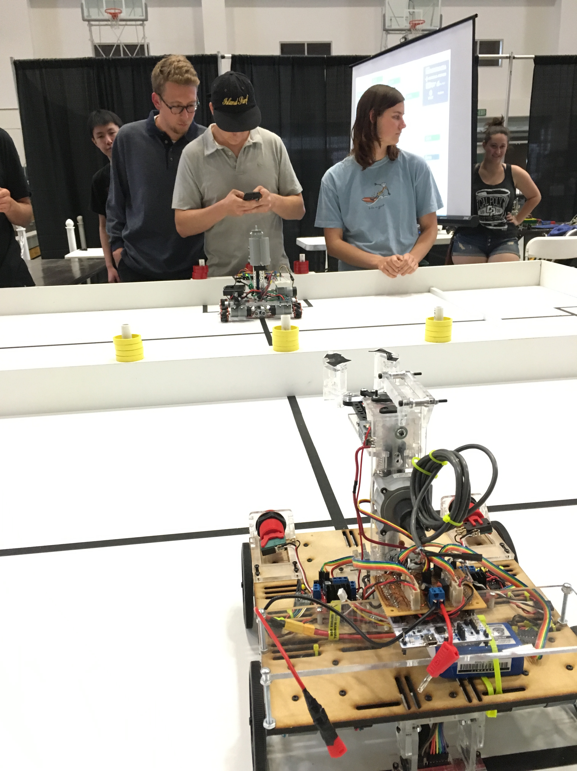
Previous Roborodentia Entries

Slide 9
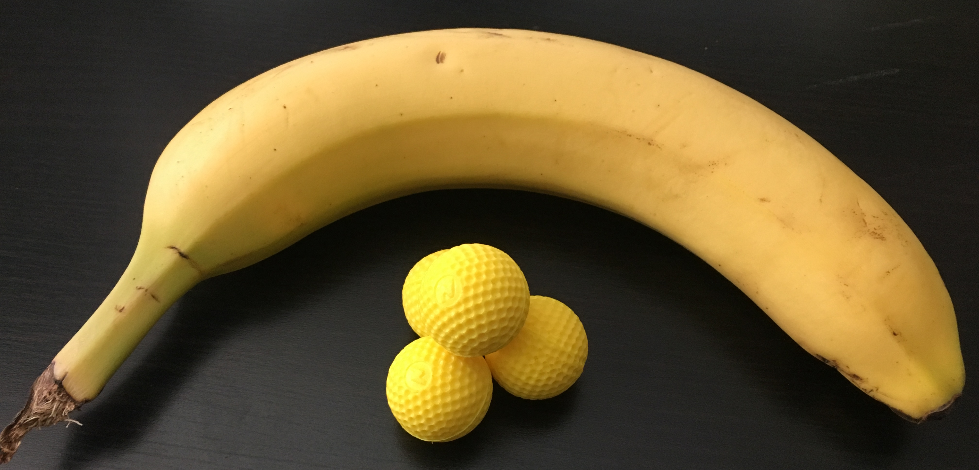
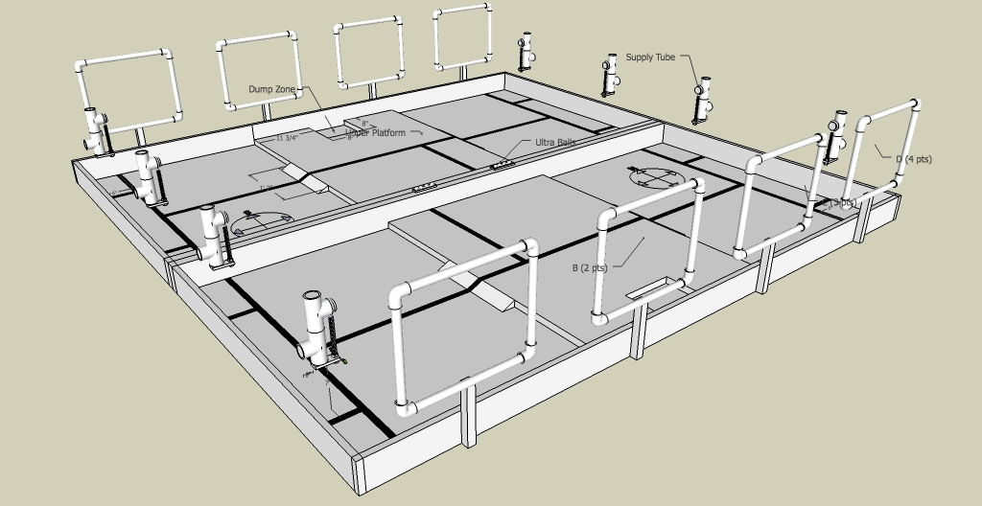
2018 Cal Poly Roborodentia
Robots obtain Nerf Rival balls from supply tubes.
Shoot balls into nets to score points.
Source: http://roborodentia.calpoly.edu/
Notes:
Introduce Roborodentia.

Slide 10
2018 Entry
Built from scratch.
Contains numerous custom parts and electronics.

Slide 11
Outline
Outline
Teaser
Introduction/Motivation
Background
Solution
Implementation
Results
Future work and conclusions

Slide 12
Reinforcement Learning
RL:
Subset of machine learning.
Solves control and action selection problems
“In-between” supervised and unsupervised learning.
Supervised learning: perform classification
Unsupervised learning: data clustering, find underlying patterns.

Slide 13
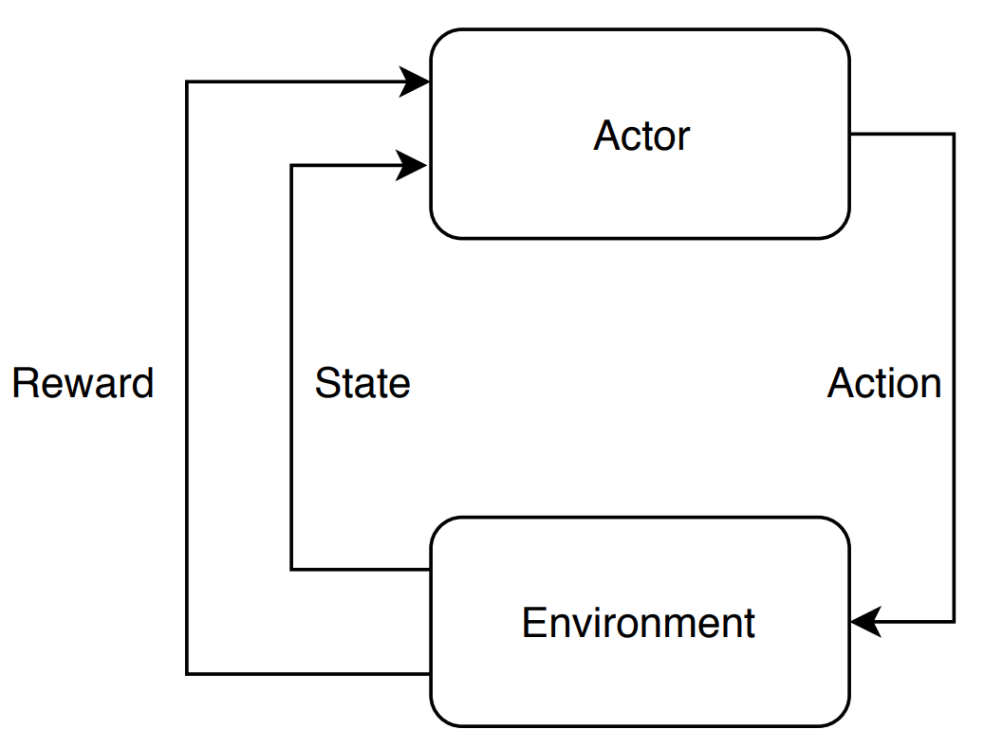
Reinforcement Learning Elements
Actor/agent
Environment
Reward/return
Policy
Value function
Sometimes a model

Slide 14
Value Functions
Indicates the long-term reward expected from a state.
Even if a state only has a small immediate reward, it may possess high value since it leads to high reward states.

Slide 15
Outline
Outline
Teaser
Introduction/Motivation
Background
Solution
Implementation
Results
Future work and conclusions

Slide 16
Outline
Outline
Teaser
Introduction/Motivation
Background
Solution
Implementation
Results
Future work and conclusions

Slide 17
Outline
Outline
Teaser
Introduction/Motivation
Background
Solution
Implementation
Results
Future work and conclusions

Slide 18
Outline
Outline
Teaser
Introduction/Motivation
Background
Solution
Implementation
Results
Future work and conclusions

